Slide 1
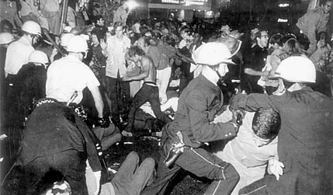
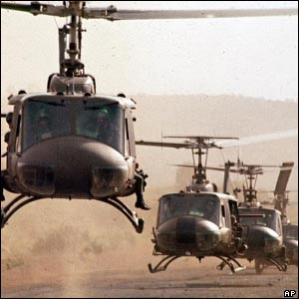
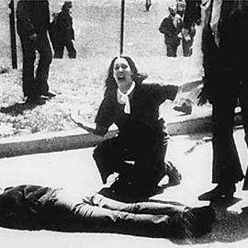
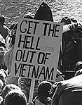
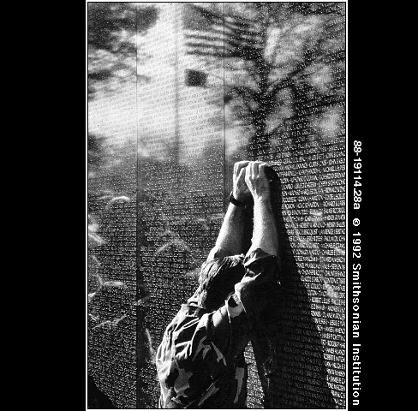
Vietnam War Unit Notes

Slide 2
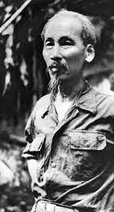
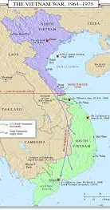
The Vietnam War
1. The Geneva Accords split Vietnam at the 17th parallel following WWII.
2. Again, like in Korea, the northern half was Communist, led by Ho Chi Minh, and supported by the Soviets.
3. The southern half was non-Communist, and was supported by the U.S.

Slide 3
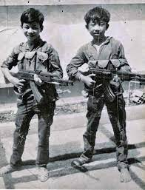
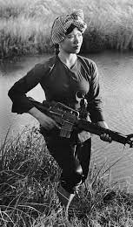
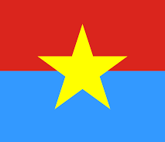
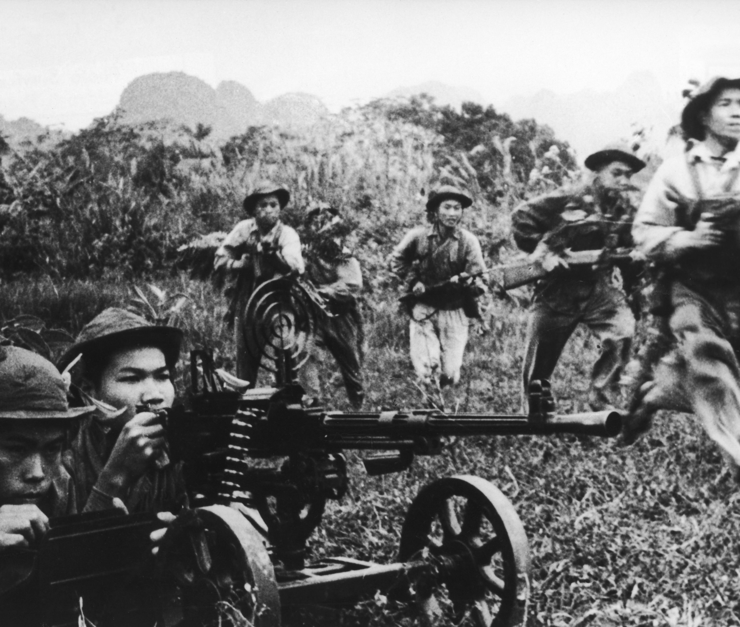
The Vietcong
1. South Vietnamese Communists backed by the North Vietnamese.
2. Their goal was to drive out the pro-U.S. gov’t and re-unite the nation.
3. They were living in the South and didn’t wear uniforms. Impossible for the U.S. to determine who was friendly or foe.
By 1961, JFK sent U.S. advisers to S. Vietnam to train army to defeat Vietcong (sometimes called the VC)

Slide 4
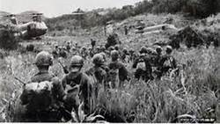
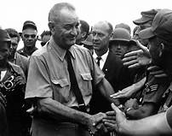
Deeper US Involvement
1. With JFK’s assassination-Lyndon Johnson became Pres.
2. LBJ was the first Pres. to send American combat soldiers to Vietnam and institute the draft.
3. Throughout LBJ’s term he significantly increased U.S. troops.

Slide 5
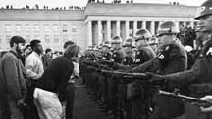
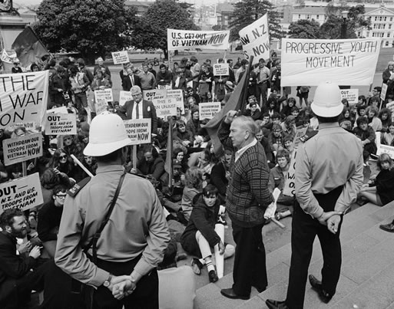
Debate over the War
1. By 1967, Americans had been fighting for 3 years, and billions of dollars spent
2. Public support decreased as thousands of U.S. troops came home in caskets.
3. Some wanted to launch a full scale invasion of N. Vietnam.(Without help from N. Vietnam, the VC in the South could not survive).

Slide 6
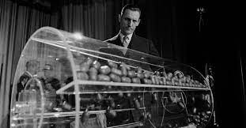
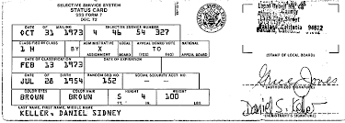
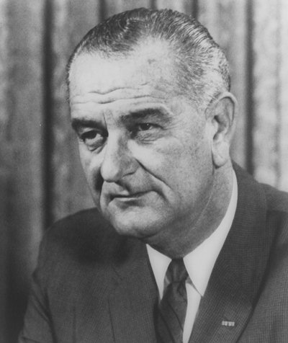
Debate over the War
4. LBJ resisted a full-scale war or a complete pullout of U.S. troops. He instead instituted a draft.

Slide 7
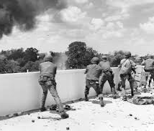
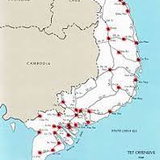
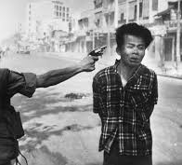
The Tet Offensive
1. 1968, was the beginning of Tet, the Vietnamese New Year. (Holiday Cease fire)
2. VC launched surprise attacks on cities all over S. Vietnam.
3. Attacks were in Saigon, directed at the U.S. embassy. (All caught on TV)
4. It seemed that the VC were everywhere-not just in jungle but in cities

Slide 8
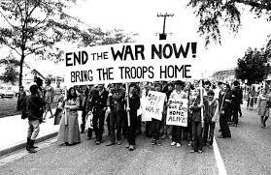
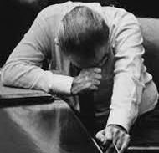
Tet Offensive Continued
5. The VC were quickly crushed by the Americans, but the damage was done.
6. Politically this was a huge victory for the VC. Proved on TV that the VC were still active despite LBJ’s claim.
7. Many Americans turned against involvement. Ending the war became a priority, not winning it.

Slide 9
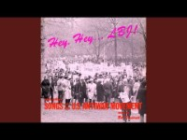
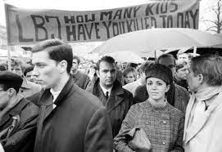
Tet Offensive Continued
8. “Hey, hey, LBJ…………”?

Slide 10
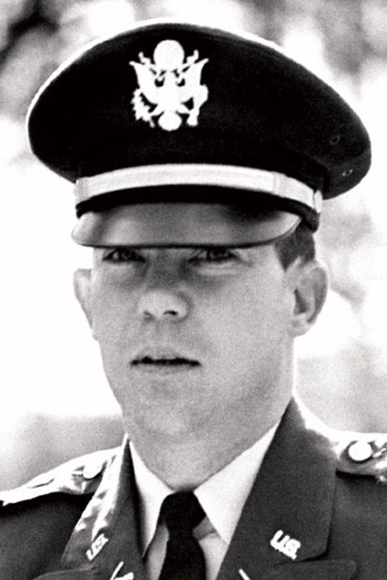
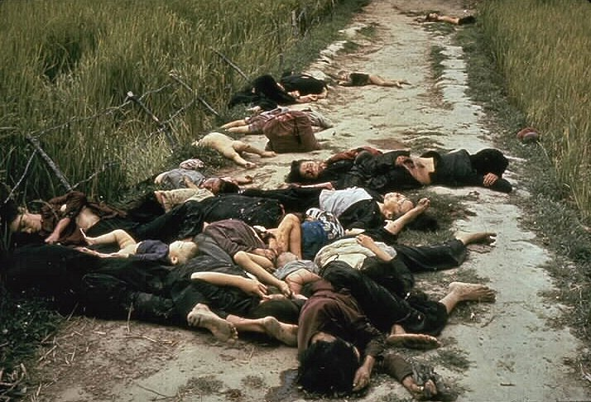
My Lai Massacre

Slide 11
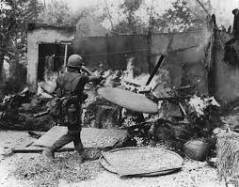
1. Americans became aware of this incident from a NY Times reporter .
2. A U.S. platoon under the command of LT. William Calley had massacred innocent civilians in the small village of My Lai.
3. Calley looking for Vietcong rounded up women, children and the elderly and executed more than 200.

Slide 12
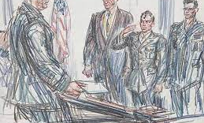
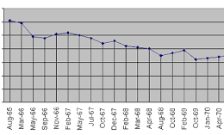
4. Twenty-five soldiers were charged with some degree of discipline, but only Calley was convicted and imprisoned.
5. Soldiers of his unit said they were just taking orders from their lieutenant.
6. Public Opinion turned even more negative.

Slide 13
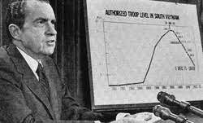
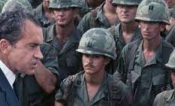
Nixon Winds Down U.S. Involvement
1. 1968, Nixon becomes Pres.-LBJ decided not to run again.
2. Nixon began slow process of Vietnamization,-turning the war slowly over to the S. Vietnamese army while the U.S. withdraws.
3. Finally in 1972, the last American troops left Vietnam.

Slide 14
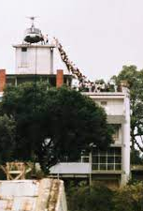
4. Without American military support the S. Vietnamese Army was too weak to defend itself.
5. 1975, the North launched a giant offensive against the South. S. Vietnamese Gov’t collapsed, N and S were re-united but now under Communist rule.

Slide 15
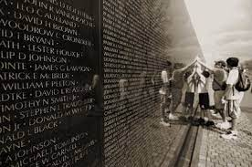

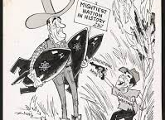
The Effects of the War
1. 58,000 U.S. soldiers killed.
2. Drained billions of dollars of nations economy.
3. Shook Americans faith and trust in government.
4. Raised new doubts about whether the U.S. should be involved in foreign conflicts.(Return to an Isolationist foreign policy)

